Slide 1
Introduction to Spatial Data Science and Machine Learning Urban Design B-Pro 2022/2023 Liam Thomas Bolton PhD Architectural Space and Computation student and PGTA

Slide 2
Overview
The aim of the workshops is to provide an introduction to spatial data science and machine learning with Python:
Python programming for spatial data science
Spatial data, formatting
Data vis and mapping
Machine learning

Slide 3
Schedule
01. Spatial Data - November 11th 2022
02. Visualisation - November 18th 2022
Data visualisation: concepts and methods
Mapping techniques
Python for mapping and data visualisation
03. Modelling - November 25th 2022 – CANCELLED (UCU STRIKES)
04. Machine Learning - December 2nd 2022

Slide 4
Workshop Resources
The workshop material – including presentation slides, data and notebooks – has been uploaded to Github:
https://github.com/lbuk/UD_Intro_SDSML2022

Slide 5
02. Visualisation 02_visualisation - data - notebook

Slide 6
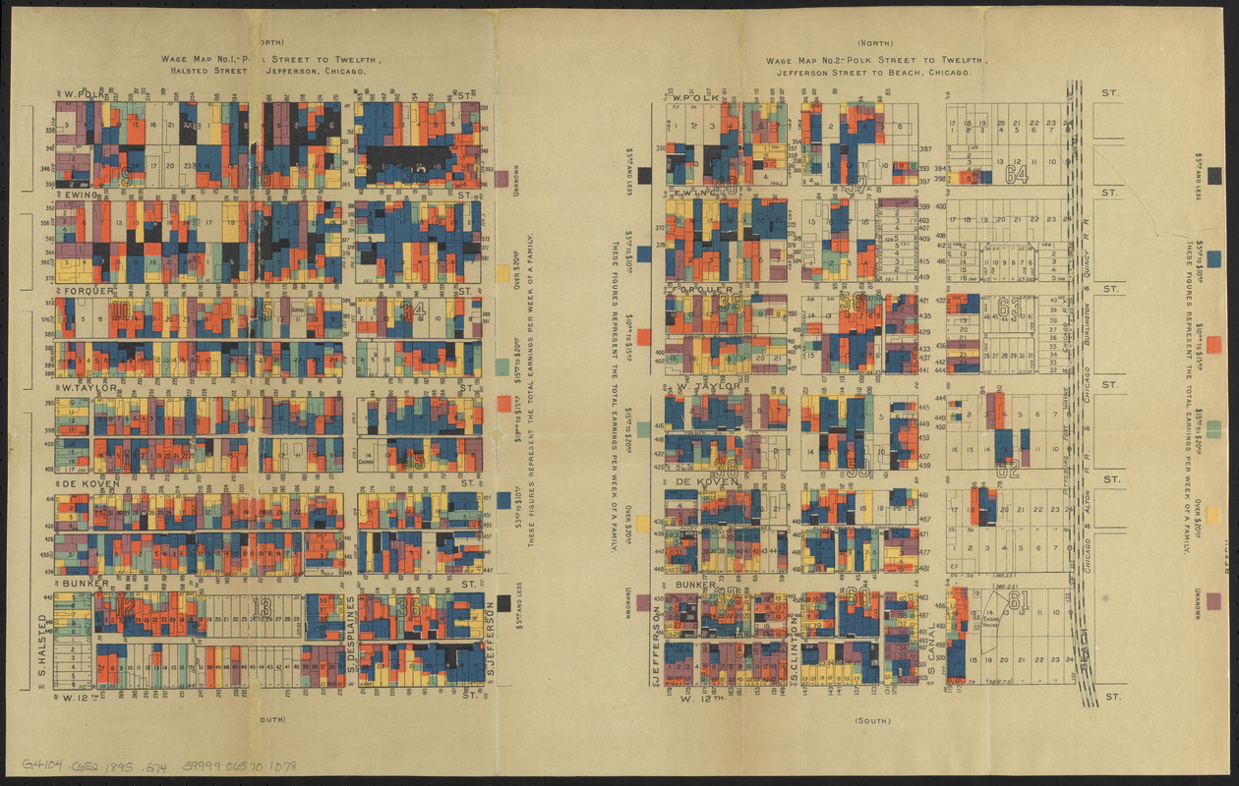
Mapping
Maps are essential to our understanding of cities and the built environment.
Mapping is an art as much as a science.
The history of mapping includes innovations across a range of disciplines.
Florence Kelley, https://en.wikipedia.org/wiki/Florence_Kelley

Slide 7
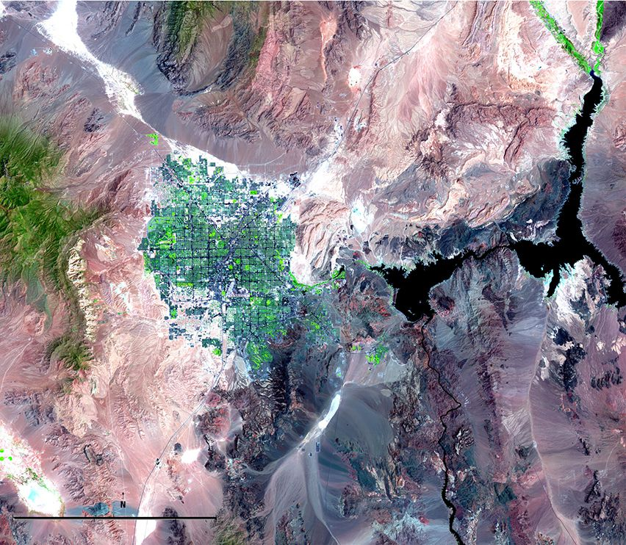
New technologies have transformed mapping and our understanding of the world.
Satellites, for example, have enabled us to map cities at unprecedented granularities.
National Geographic, https://www.nationalgeographic.org/activity/satellite-imagery-and-change-over-time/

Slide 8

New forms of data such as Light Detection and Ranging (LiDAR), a form of 3D laser scanning, are increasingly being utilised in spatial data science by urban practitioners.
National Geographic, https://www.nationalgeographic.com/magazine/article/explore-lidar-imaging-technology-dublin

Slide 9
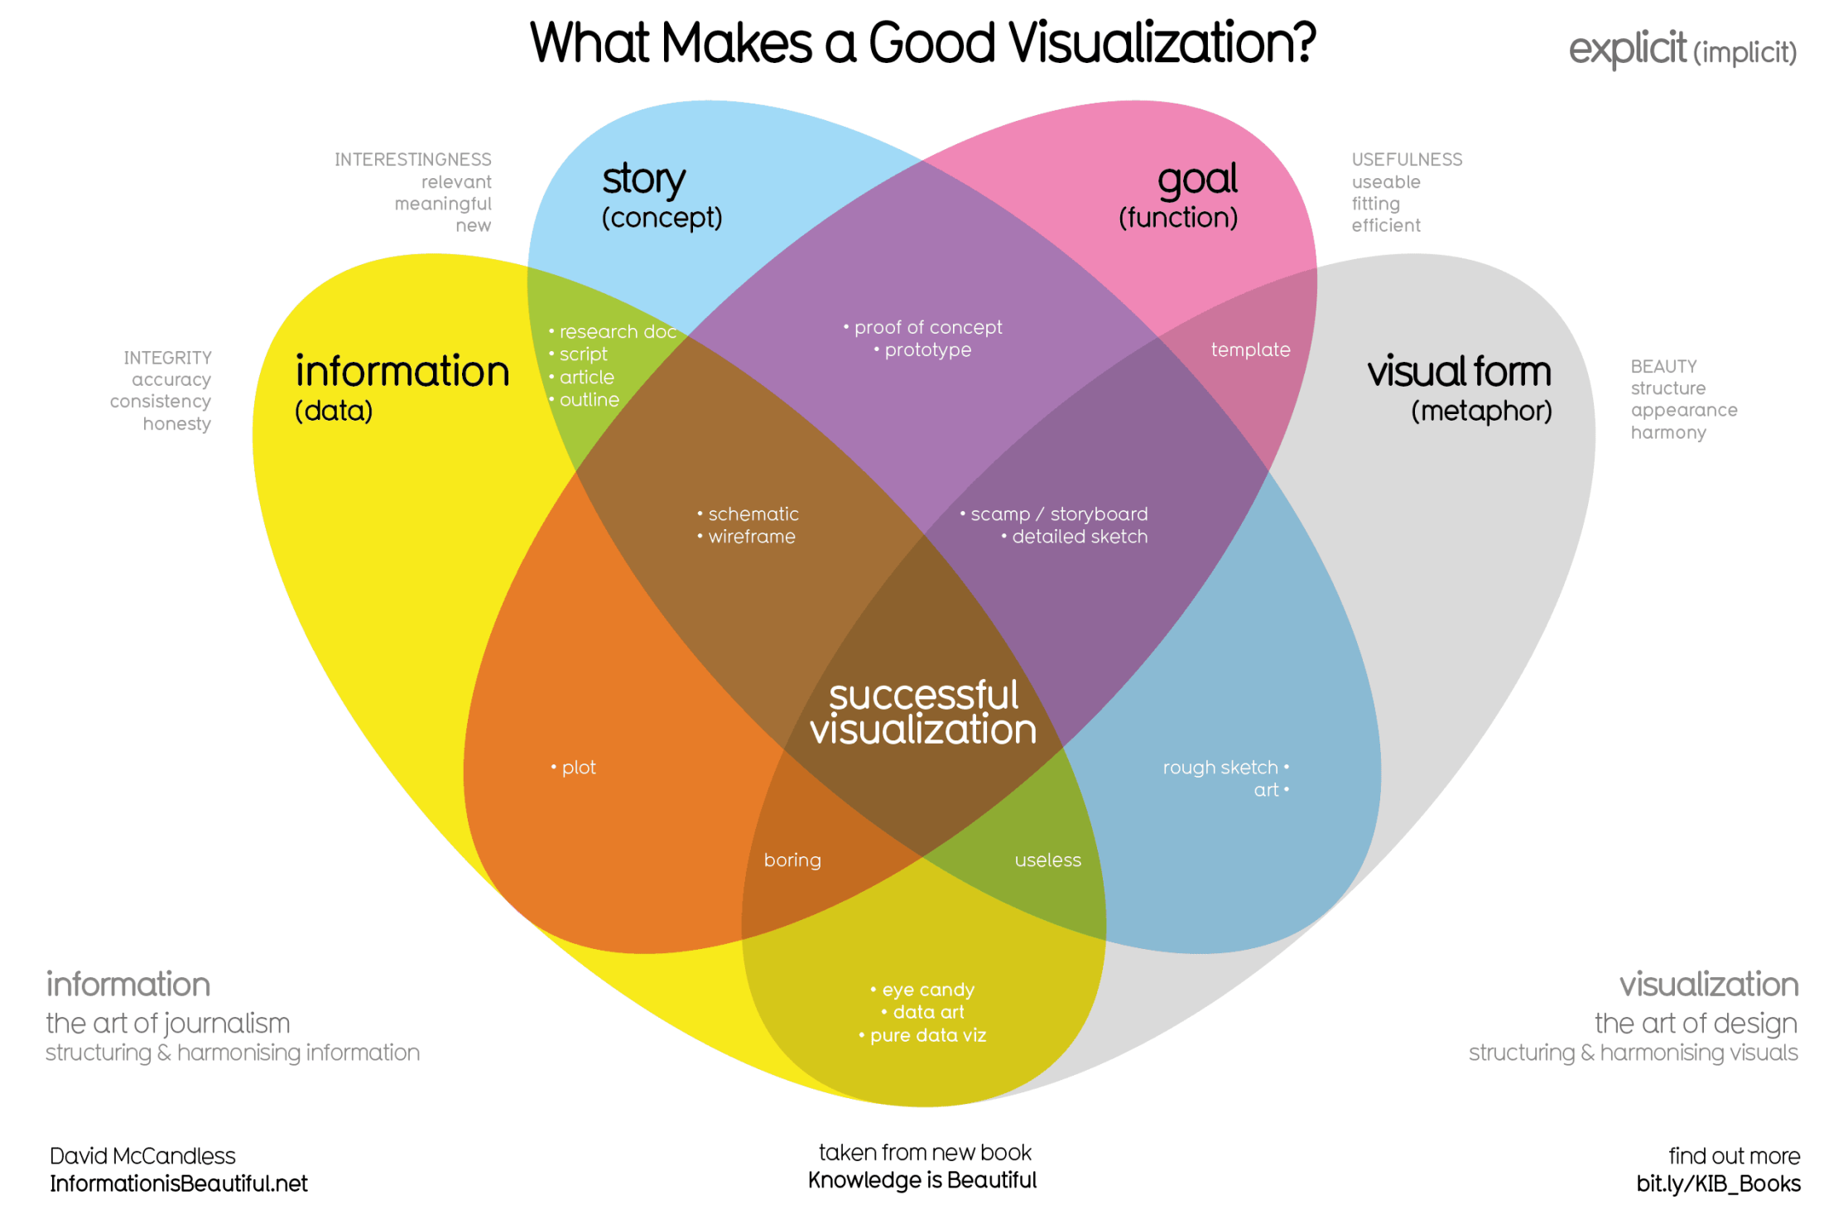
Information is Beautiful, https://www.informationisbeautiful.net

Slide 10
Data Visualisation Checklist
Principles
Exploratory or Explanatory
Equitable
Accessible
Components
Title
Axis
Legend
Marks
Annotation
Labels
Data sources
Foundation
Colour
Typography
Responsiveness
VR/AR
Visualisations
Choropleth map
Dasymetric map
Dot density map
Proportional symbol map
Flow map
Cartogram
Content
Voice and Tone
Grammar and Mechanics
Language and Inclusivity
Data Visualization Style Guidelines, https://www.datavizstyleguide.com/checklist

Slide 11
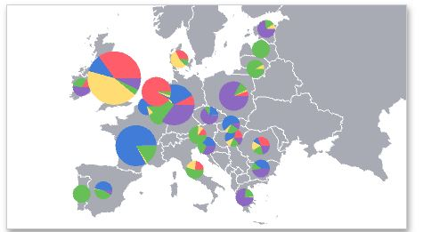
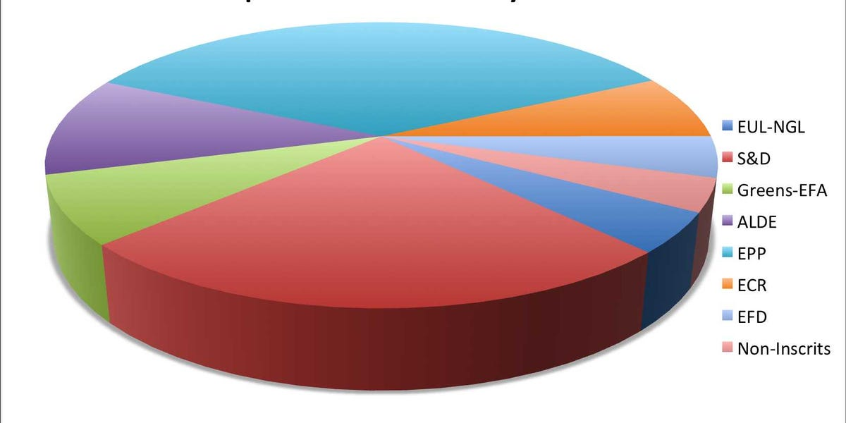
As a rule, don’t use pie charts.

Slide 12
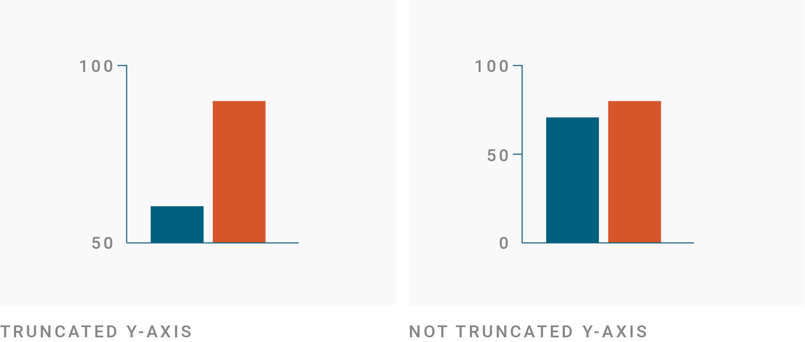
Don’t mislead with data vis.
Example: the y-axis of charts should (almost always) start at zero.
Datawrapper, https://academy.datawrapper.de/article/326-why-our-column-and-bar-charts-start-at-zero

Slide 13

Maps can be utilised to mislead and distort data.
The Washington Post, https://www.washingtonpost.com/outlook/2019/09/06/why-president-trumps-sharpied-weather-map-was-likely-crime-should-be/

Slide 14
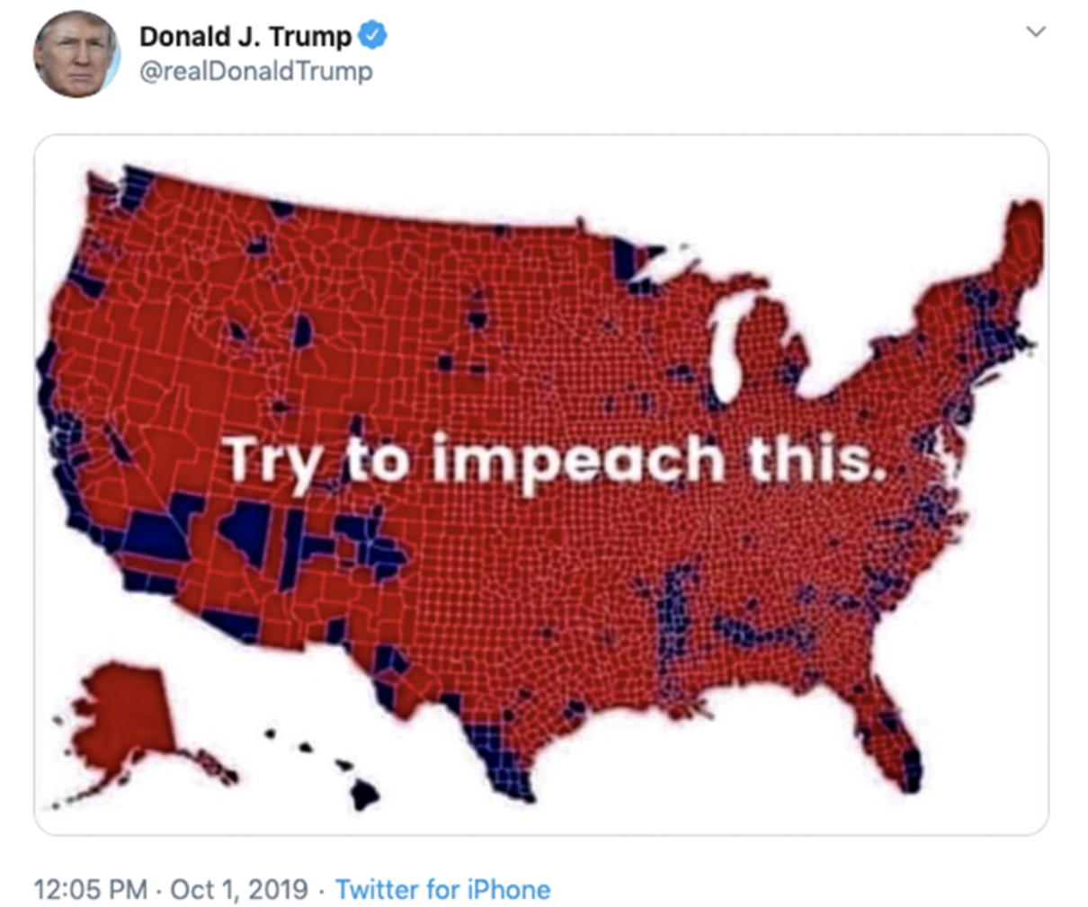
Maps can be utilised to mislead and distort data.
https://twitter.com

Slide 15
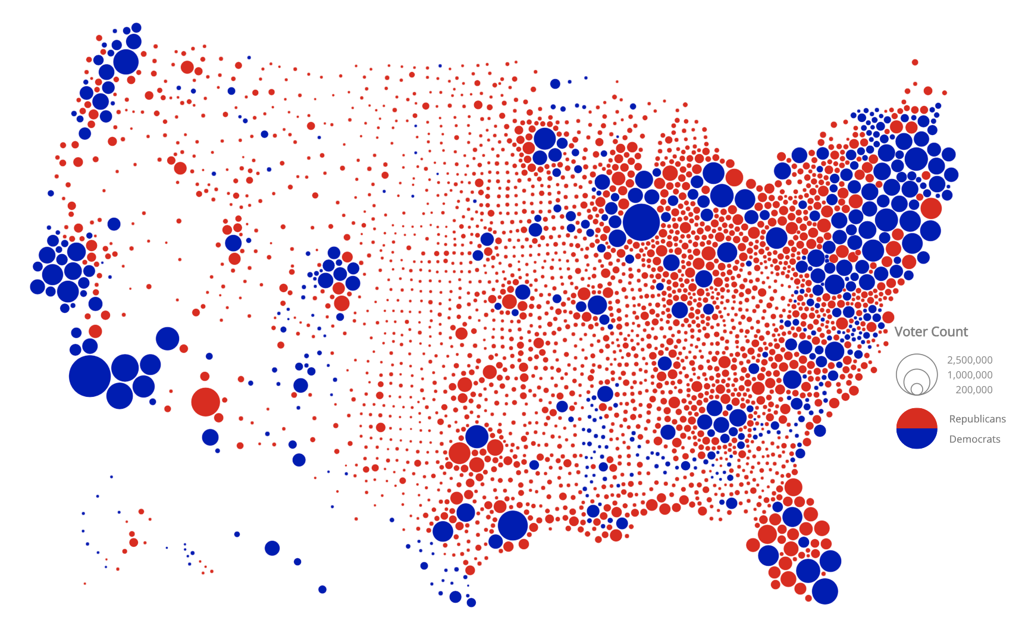
https://try-to-impeach-this.jetpack.ai/

Slide 16
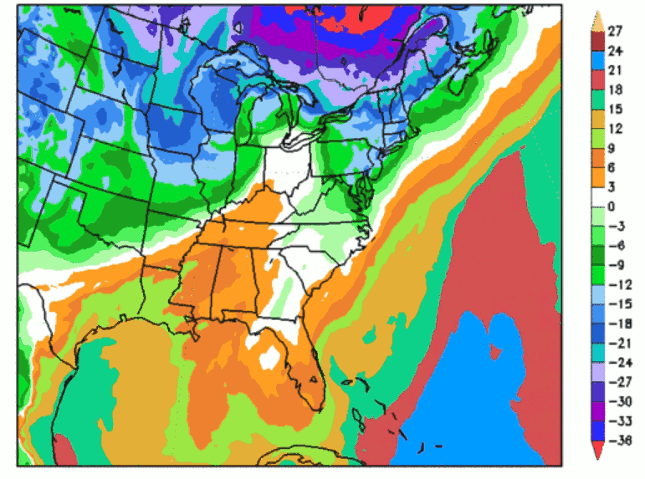
Palettes
Design palettes wisely.
Weather maps frequently utilise poorly-designed palettes.
colorspace, https://colorspace.r-forge.r-project.org/

Slide 17
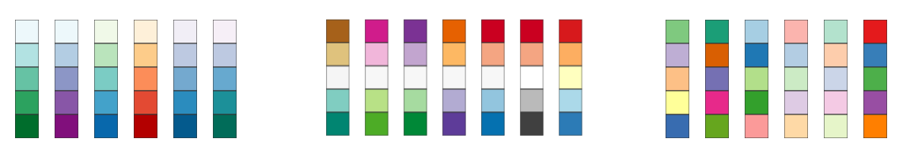
Sequential
Diverging
Qualitative
ColorBrewer, https://colorbrewer2.org/

Slide 18
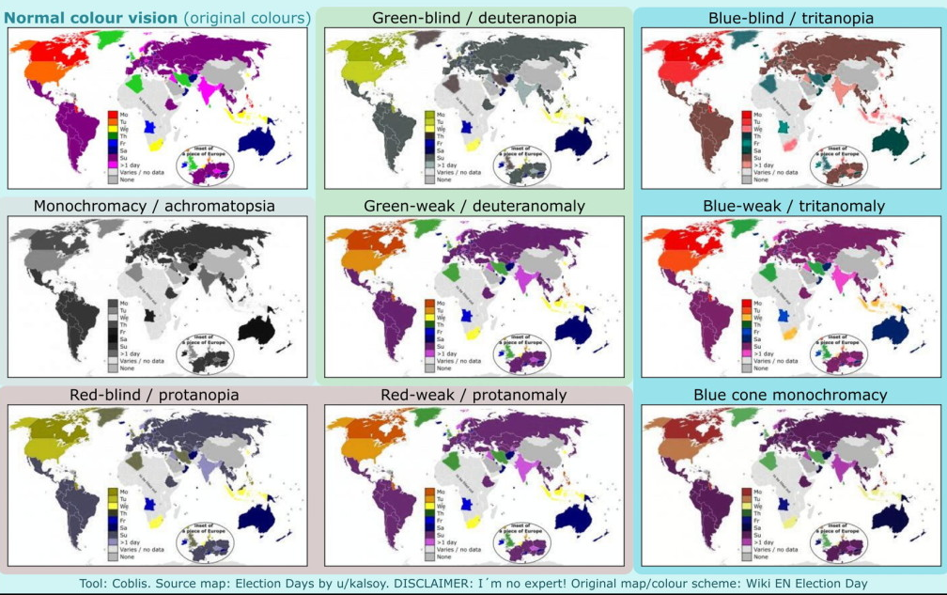
Design maps for colourblindness.
The Map Room, https://www.maproomblog.com/2016/03/map-colours-and-colour-blindness/

Slide 19
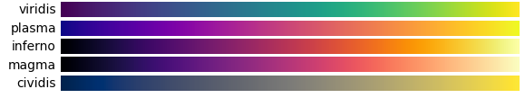
Viridis
Colourblind-friendly palettes, multiple hues, render detail well.
Matplotlib, https://matplotlib.org/stable/tutorials/colors/colormaps.html

Slide 20
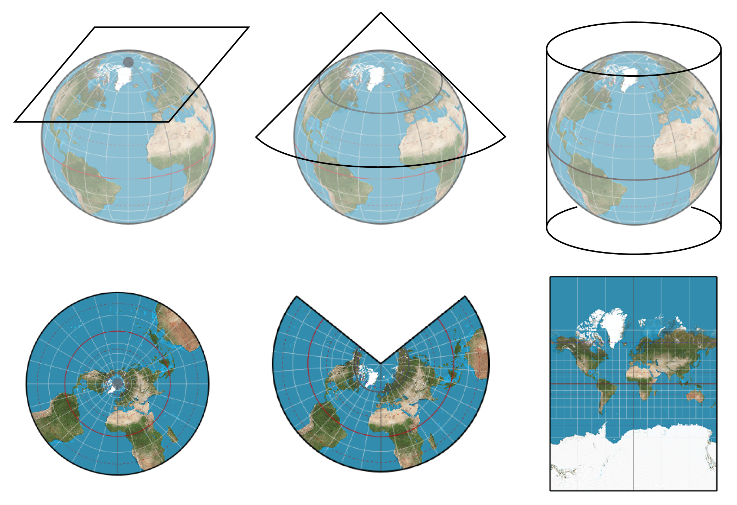
Coordinate Reference Systems
Coordinate Reference Systems enable us to transfer three-dimensional spaces onto two-dimensional surfaces like maps.
Coordinate Reference Systems can vary from place-to-place and can be utilised for different purposes. Always ensure that your map has the correct Coordinate Reference System.
GIS&T Body of Knowledge, https://gistbok.ucgis.org/bok-topics/2018-quarter-02/map-projections

Slide 21
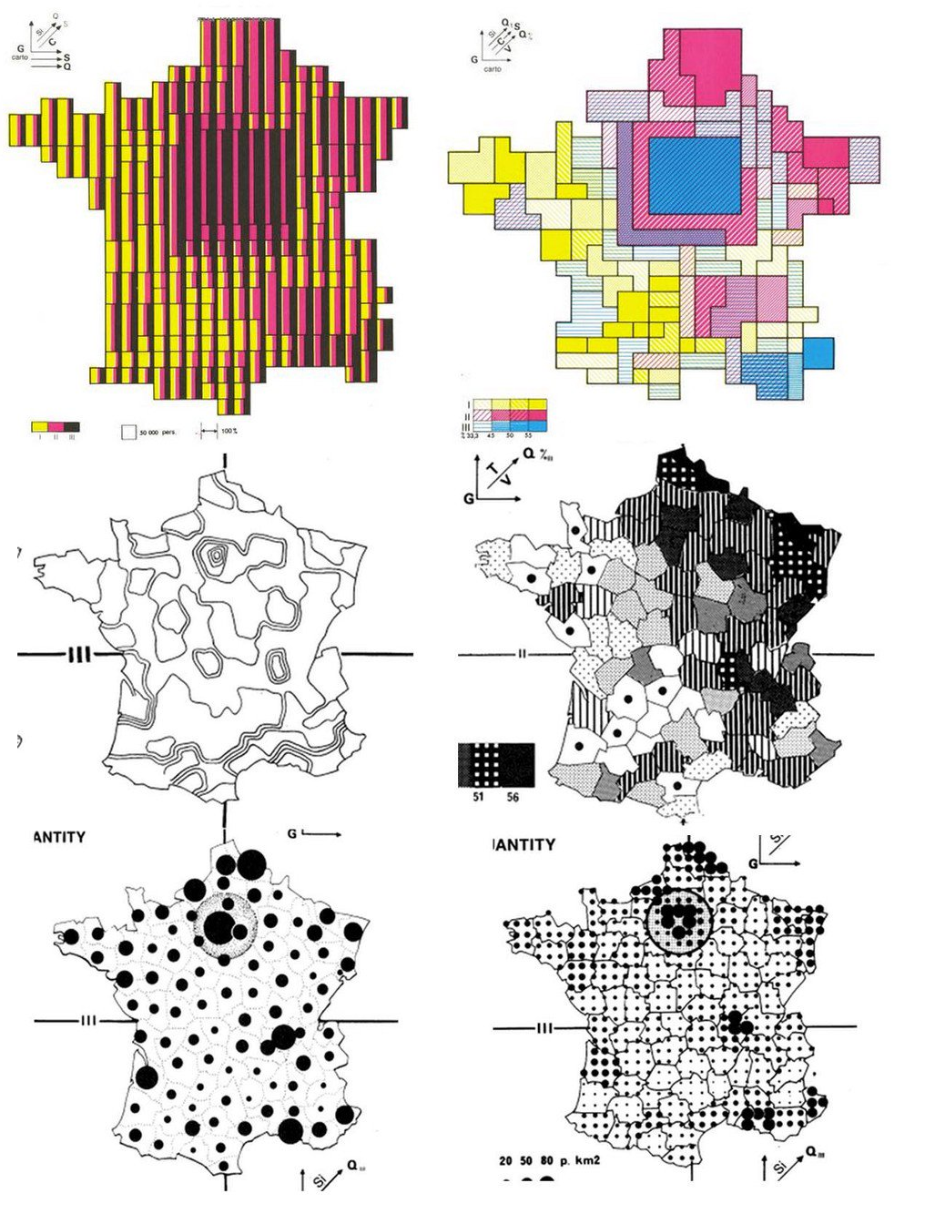
Mapping Techniques
Spatial data can be depicted utilising a range of techniques such as choropleth maps, proportional symbol maps and dot density maps.
Jacques Bertin, https://en.wikipedia.org/wiki/Jacques_Bertin

Slide 22
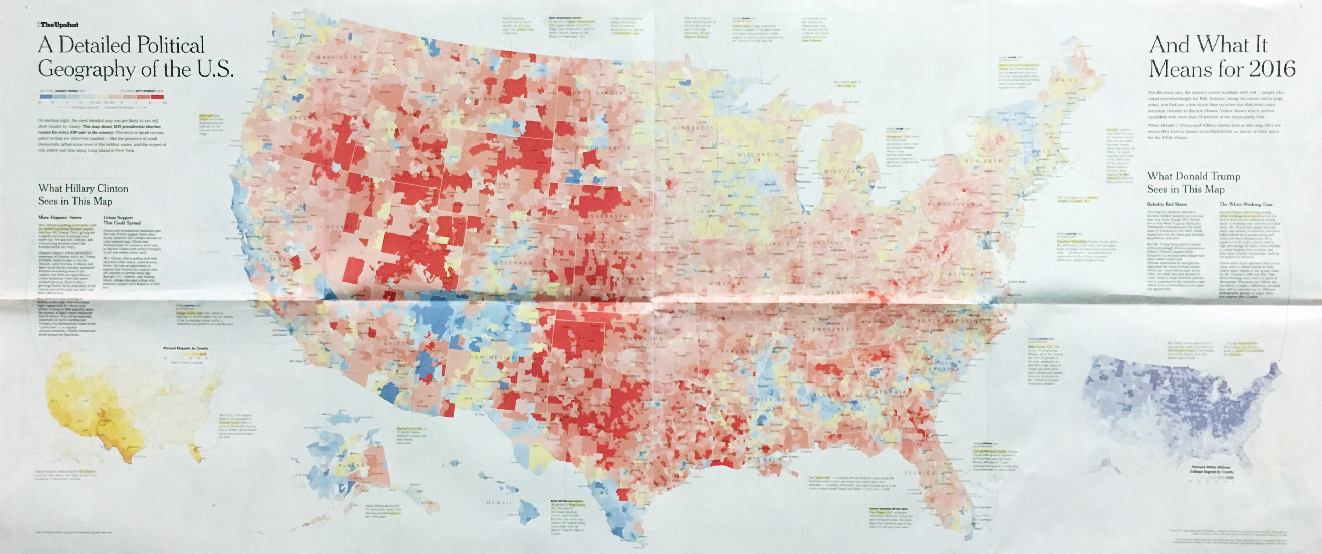
Choropleth Maps
Geographic areas are shaded according to a variable.
Note:
Choropleth maps can be effected by the Modifiable Areal Unit Problem (MAUP).
The New York Times, https://www.nytimes.com/interactive/2016/11/01/upshot/many-ways-to-map-election-results.html

Slide 23
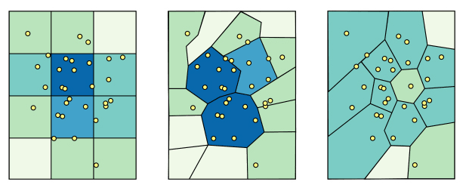
Thematic maps can be affected by the Modifiable Areal Unit Problem (MAUP), which happens when statistical data is summarised to geographic areas that can vary in terms of scale and zoning. This is known as the ‘scale effect’, in which the size of the geographic areas varies, and the ‘zoning effect’, in which the configuration of the geographic areas varies.
Azavea, https://www.azavea.com/blog/

Slide 24
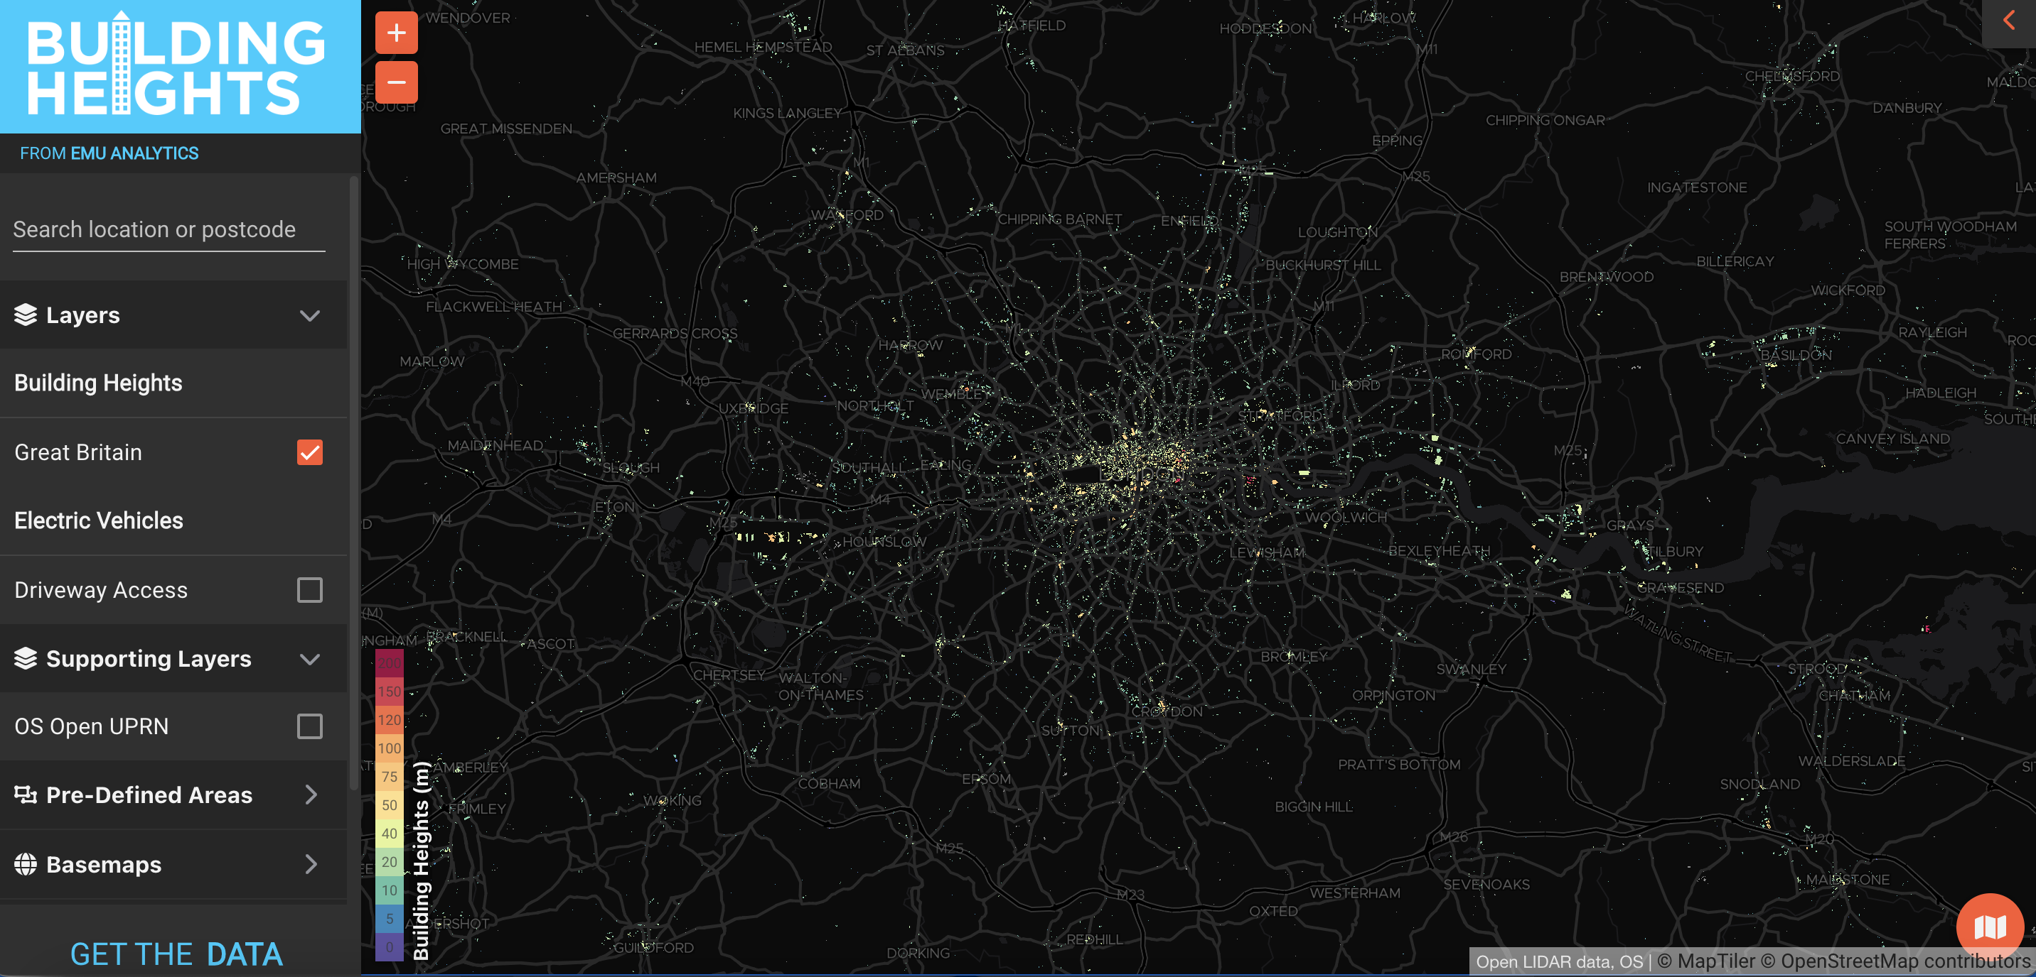
Dasymetric Maps
Ancillary information is assigned to geographic data.
Note:
Dasymetric maps tend to be more granular than choropleth maps.
Emu Analytics, https://www.emu-analytics.com

Slide 25
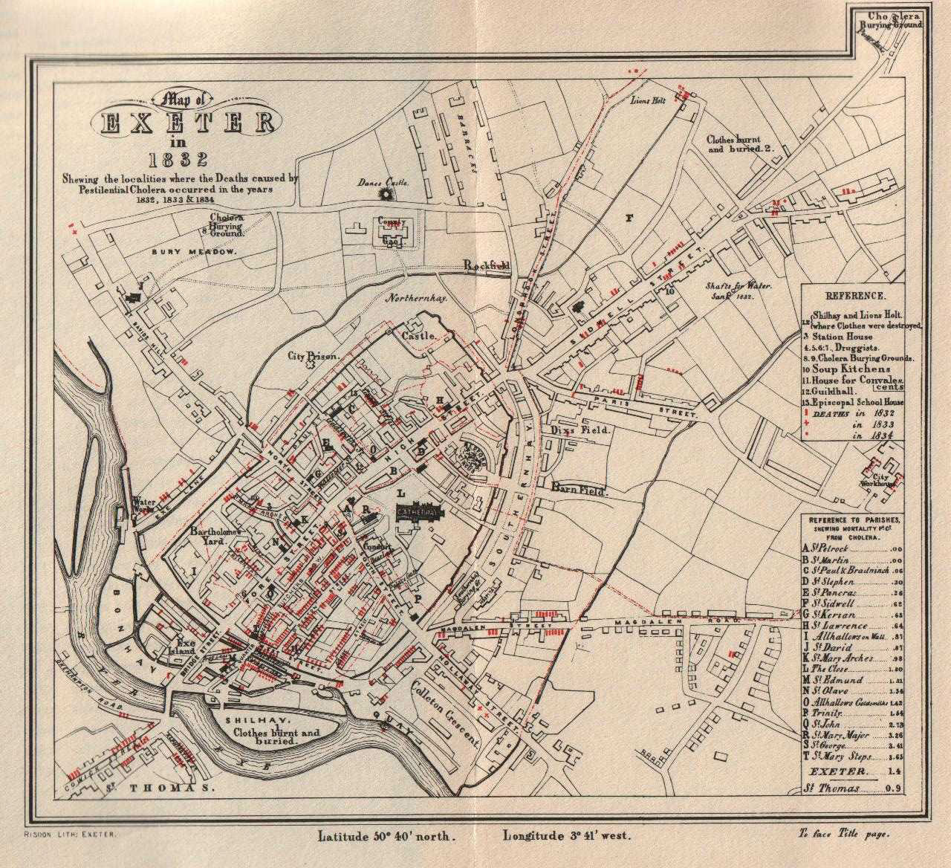
Dot Density Maps
Point symbols are utilised to show spatial distributions.
Thomas Shapter, https://en.wikipedia.org/wiki/Thomas_Shapter

Slide 26

Flow Maps
Symbols are utilised to depict flows.
Note:
There are a number of different types of flow map, some of which utilise proportionally-sized symbols.
Charles Joseph Minard, https://en.wikipedia.org/wiki/Charles_Joseph_Minard

Slide 27
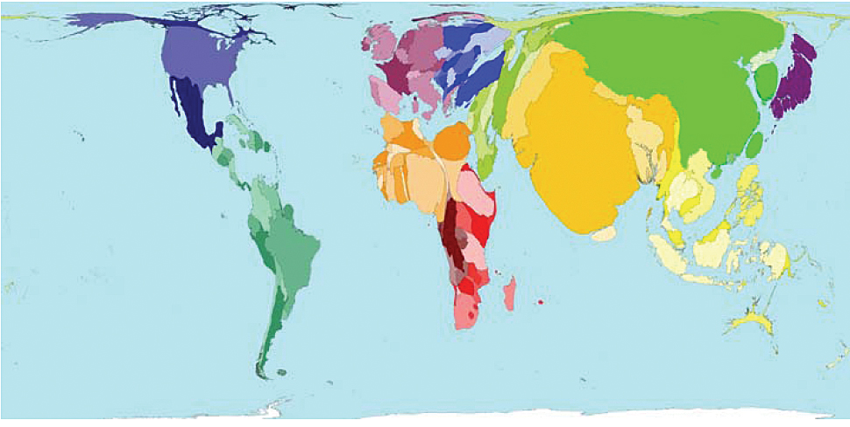
Cartograms
Geographic areas are distorted to convey a variable.
Note:
There are different forms of cartogram including contiguous, non-contiguous and Dorling cartograms.
Worldmapper, https://worldmapper.org/

Slide 28
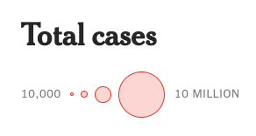
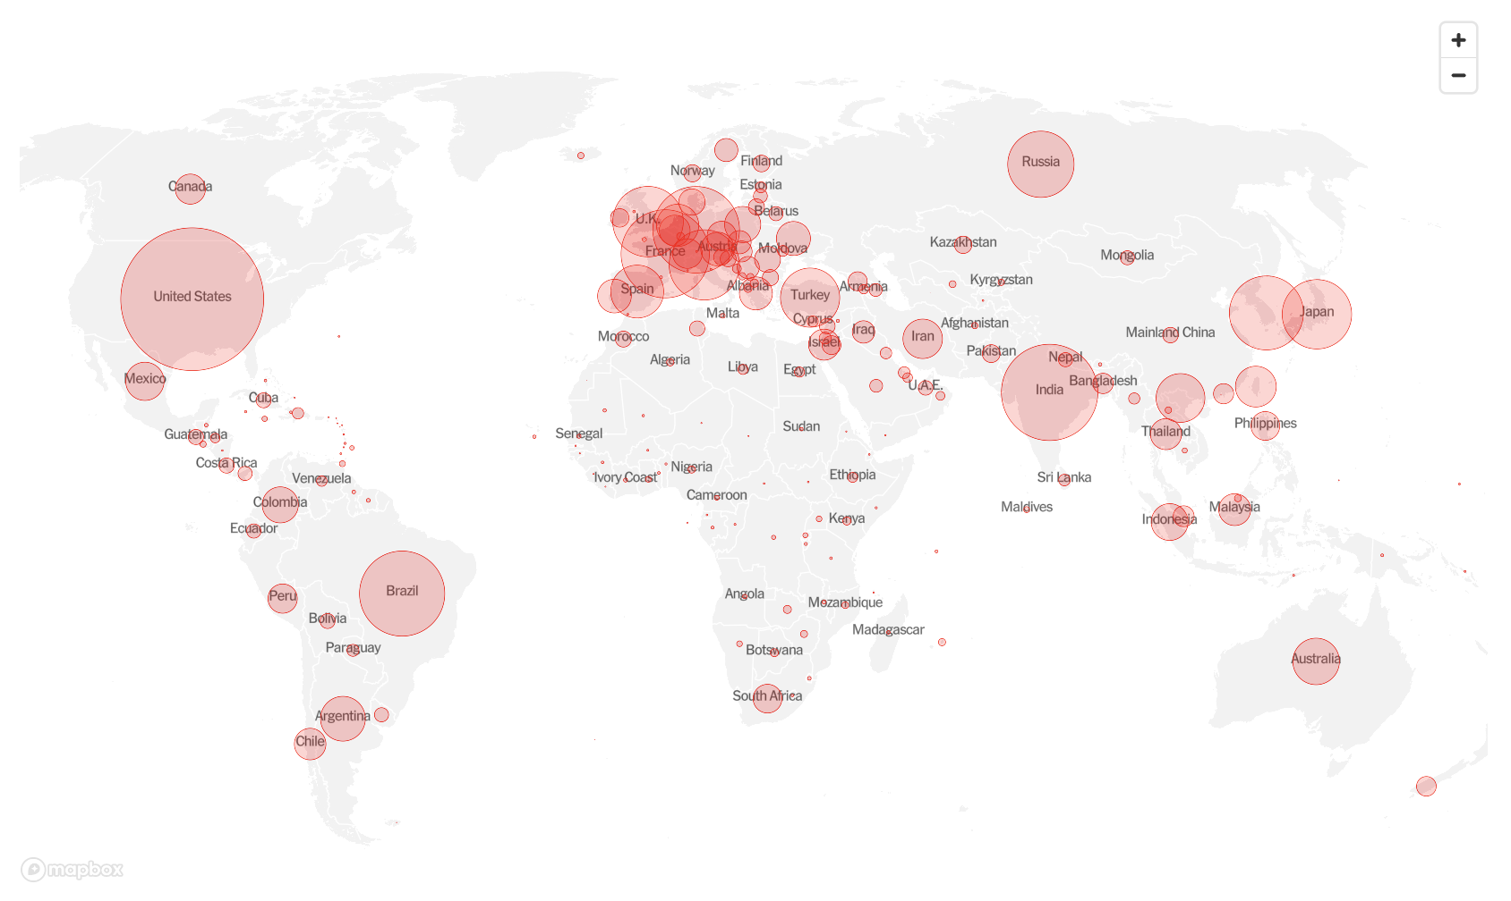
Proportional Symbol Maps
Symbols are sized according to a variable.
The New York Times, https://www.nytimes.com/interactive/2021/world/covid-cases.html

Slide 29
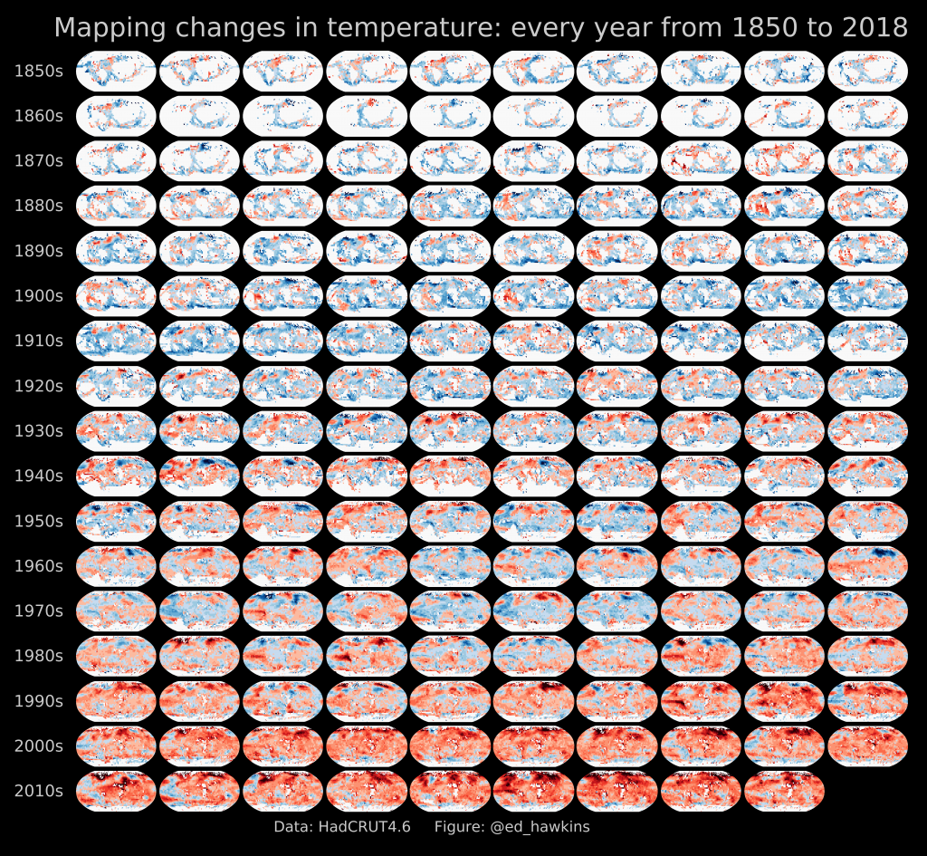
Small Multiple Maps
Multiple maps in a grid for comparison.
Ed Hawkins, https://www.met.reading.ac.uk/~ed/home/index.php

Slide 30

Data Visualisation with Python
Python has a range of
packages for performing
data visualisation: - Matplotlib
- Geopandas
- Seaborn
- Folium
- Plotly
- Geoplotlib
- Gleam
https://www.python.org/

Slide 31



https://matplotlib.org/
A Python package for data visualisation and mapping
https://python-visualization.github.io/folium/
Folium: A Python package for interactive mapping
https://seaborn.pydata.org/
A Python package for data visualisation based on Matplotlib

Slide 32
Python, Git and Jupyter Notebooks
If Jupyter is not already installed, download Anaconda (https://www.anaconda.com/) and install Jupyter Notebook or you can install it from the Terminal app with pip:
pip install notebook
Set the working directory from the Terminal app or in the Terminal in Jupyter Notebook.
Clone the workshop repo from Github using Git:
git clone https://github.com/lbuk/UD_Intro_SDSML2022
Launch Jupyter Notebook:
jupyter notebook
Select the 02_visualisation folder, the notebook folder and the 02_notebook.ipynb file

Slide 33
The Functional Art: http://www.thefunctionalart.com/ The Visual Display of Quantitative Information: https://www.edwardtufte.com/tufte/books_vdqi Semiology of Graphics: https://www.amazon.co.uk/Semiology-Graphics-Diagrams-Networks-Maps/dp/1589482611 Cartographer’s Toolkit: https://www.amazon.co.uk/Cartographers-Toolkit-Colors-Typography-Patterns/dp/0615467946 London - The Information Capital: https://www.amazon.co.uk/LONDON-Information-Capital-graphics-change/dp/1846148472 Data Visualisation Style Guidelines: https://www.datavizstyleguide.com/ Data Visualization in Python book: https://www.amazon.co.uk/Data-Visualization-Python-Daniel-Nelson/dp/B08TZ9LWWX Geoprocessing with Python book: https://livebook.manning.com/book/geoprocessing-with-python Geographic Data Science with Python book: https://geographicdata.science/book/intro.html Python Foundation for Spatial Analysis: https://courses.spatialthoughts.com/python-foundation.html Introduction to Python for Geographic Data Analysis book: https://pythongis.org/
Resources

